Slide 1
Collide
Interactive Medium-Fi Prototype

Slide 2
Our Mission
The problem:
When transitioning to a new environment, people find it difficult to make meaningful connections and are fearful of reaching out.
Our solution:
We want to solve this by creating opportunities for people, who would have otherwise passed by each other, to stop and talk.
Value Prop
Your next best friend is just around the corner.
Notes:
Same slide from A5.

Slide 3
Values Encoded
Privacy
Providing users total agency as to how much information and when they would like to share about themselves on the platform
Security
Information that users share with the platform should be encrypted and secure
Efficiency
Making the UI as simple and intuitive as possible for as many audiences as possible
Potential Conflicts
The addition of confirmation modals and permission notifications for the users certainly ensures privacy for all users, but sacrifices some user convenience.
However, user privacy must take priority, as interaction with strangers have numerous safety implications.

Slide 4
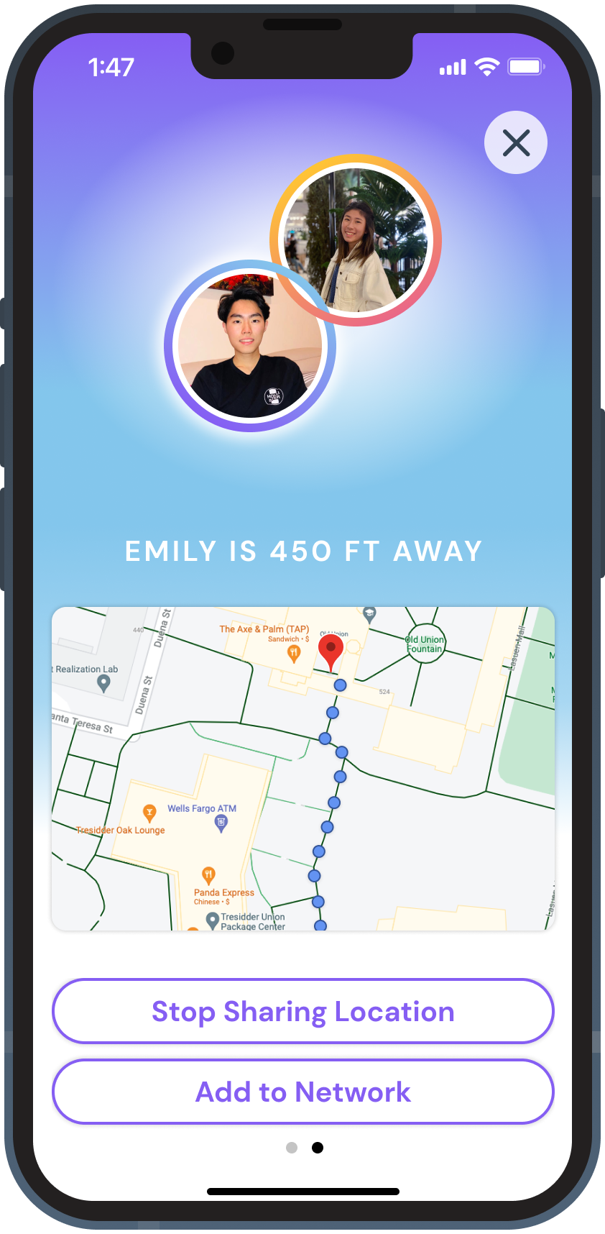
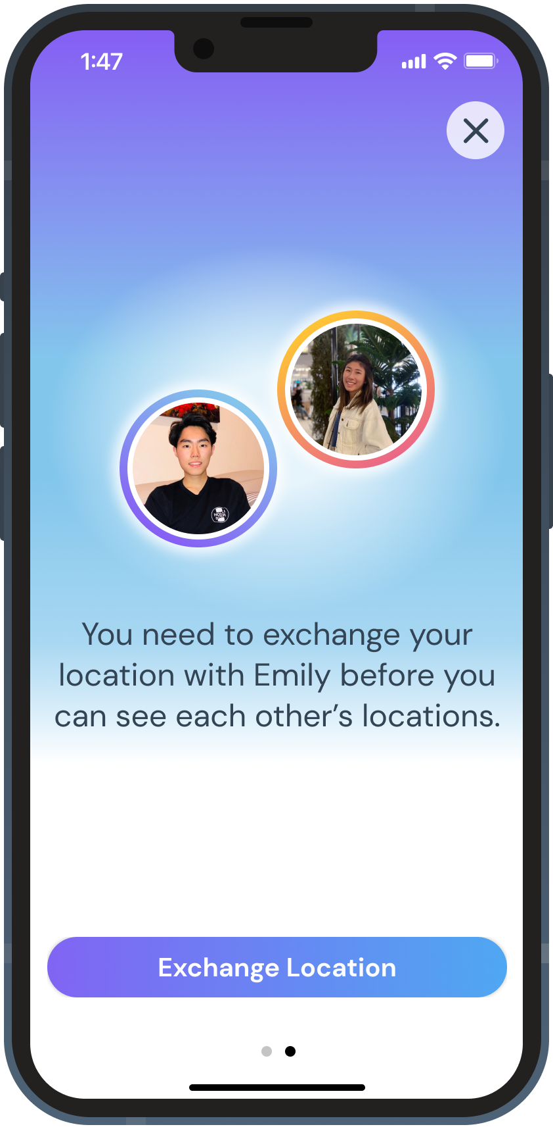
Values Encoded: Design Features
Privacy
Location sharing was the primary concern based on our user interviews. We added an explanation and a “Stop Sharing Location” button to increase the clarity and flexibility of information being shared.
Security
Information encryption will occur in the backend in the hi-fi prototype
Efficiency
Our tasks have multiple paths to completion and have clear action buttons progressing through the flow (refer to Figma prototype)

Slide 5
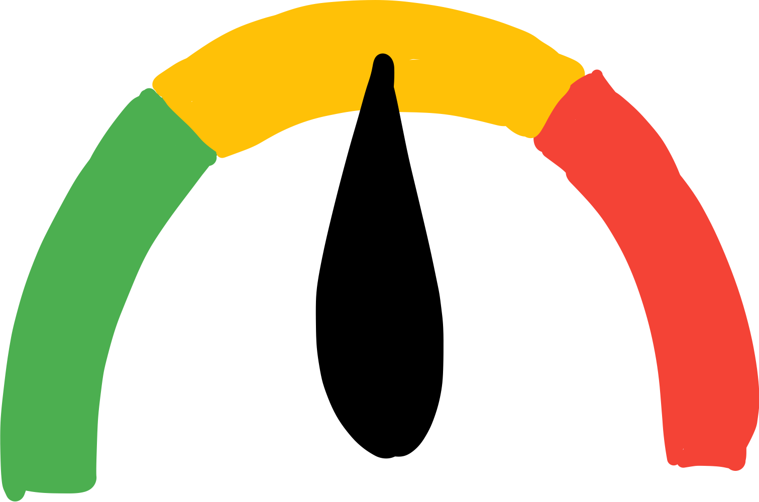
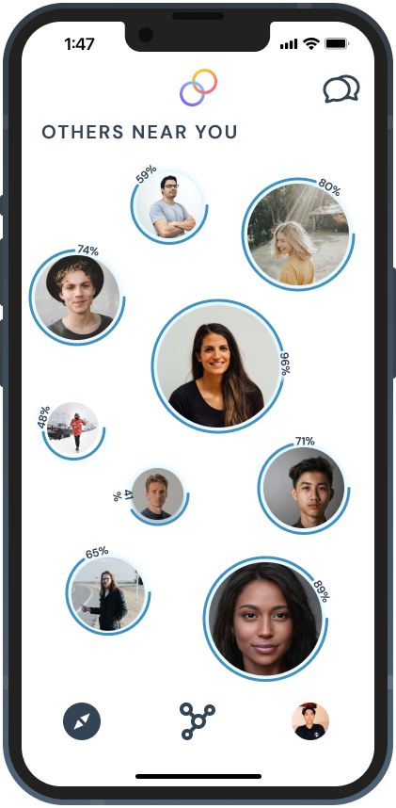
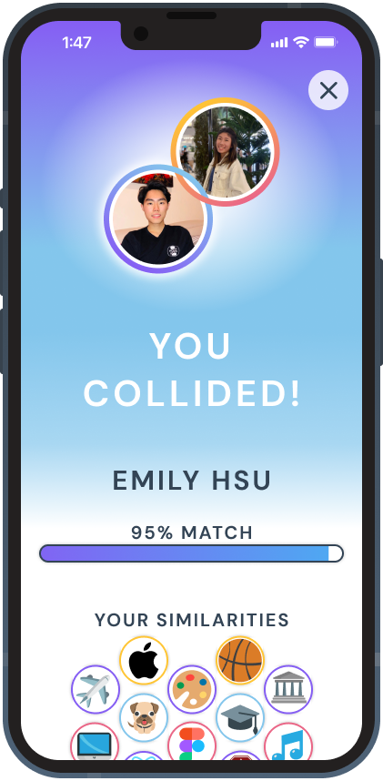
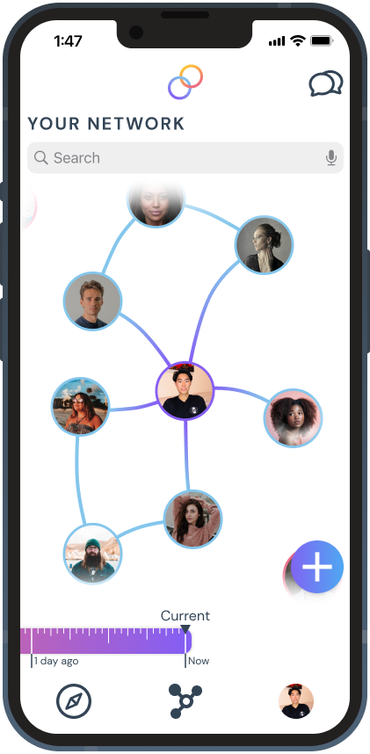
Tasks
Simple Task
Befriend someone near you with similar interests.
Moderate Task
Start a conversation with someone in person.
Complex Task
Add a past friend to your existing network.

Slide 6
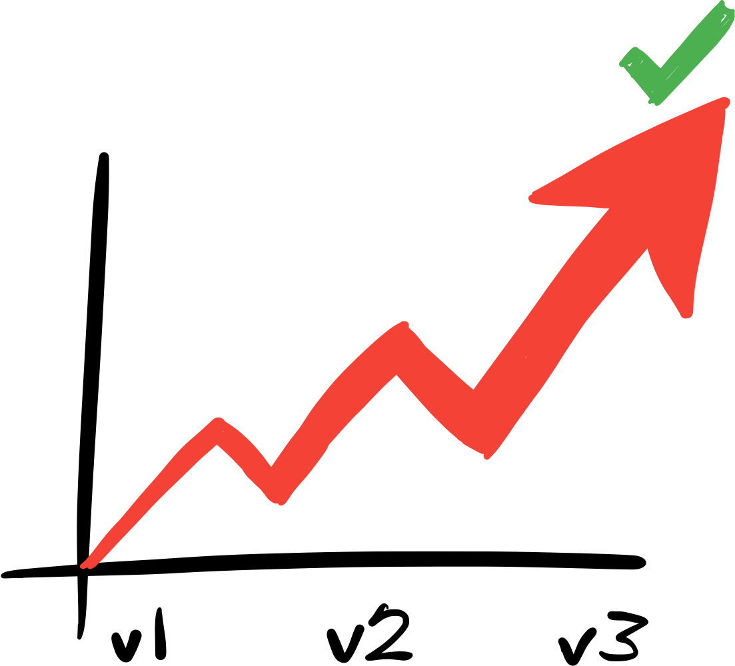
Usability Goals & Key Measurements
Usability Goals:
Robust
Efficient
Key Measurements
Observing how much Level of Interference was necessary for the user to complete the provided tasks
Asking each participants on intuitiveness of positioning, sizing, and form of objects in each screen in conveying their purpose

Slide 7
Usability Goals & Key Measurements
How our product is hitting usability goals:
Implementing minimalistic designs with each screen along with visual explanation(s) on screens where test users felt uncertainties in functionality, and placing permission modals in places where they felt unsafe sharing their information allow us to have a platform that is both robust and efficient.
To Continue Progression:
The medium-fi prototype must be have consistent, immediately-intuitive UI across all the tasks.

Slide 8
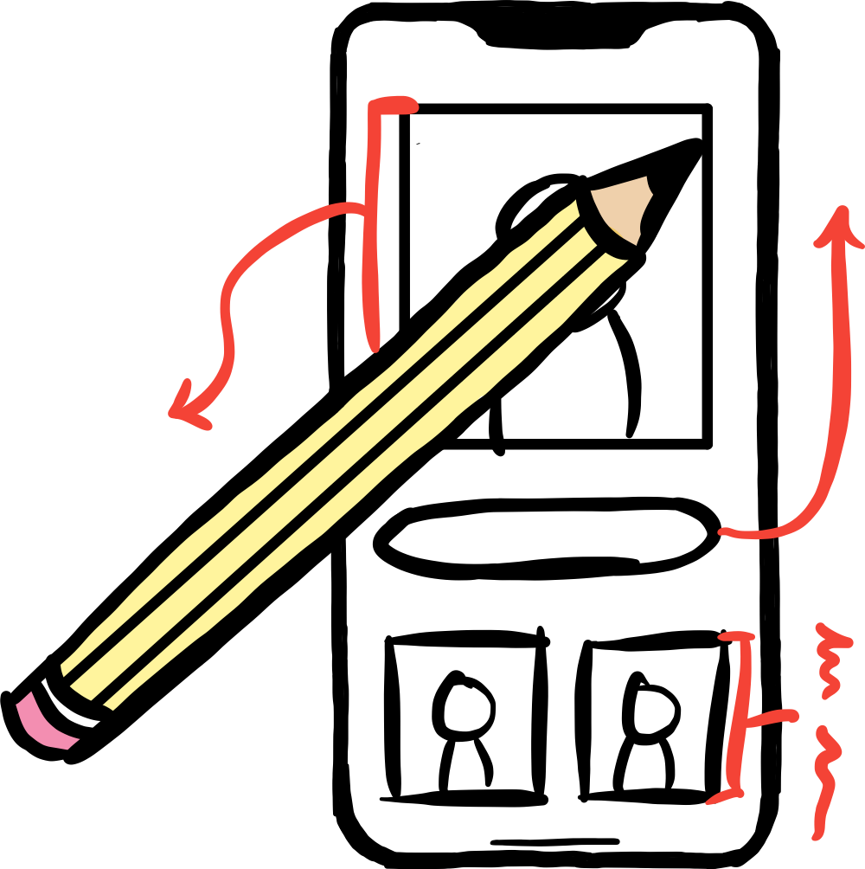
Revised Interface Design

Slide 9
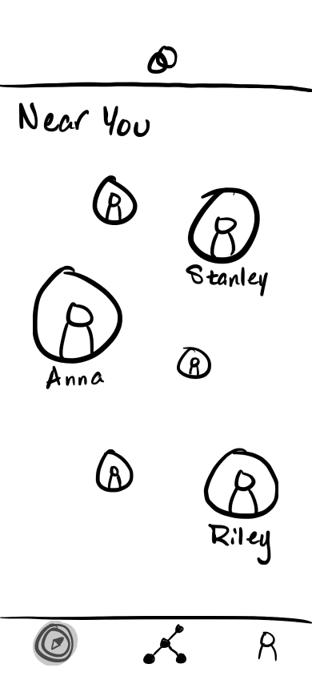
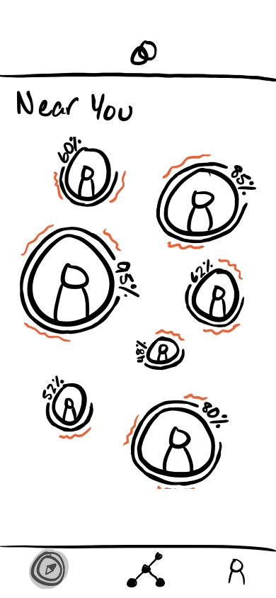
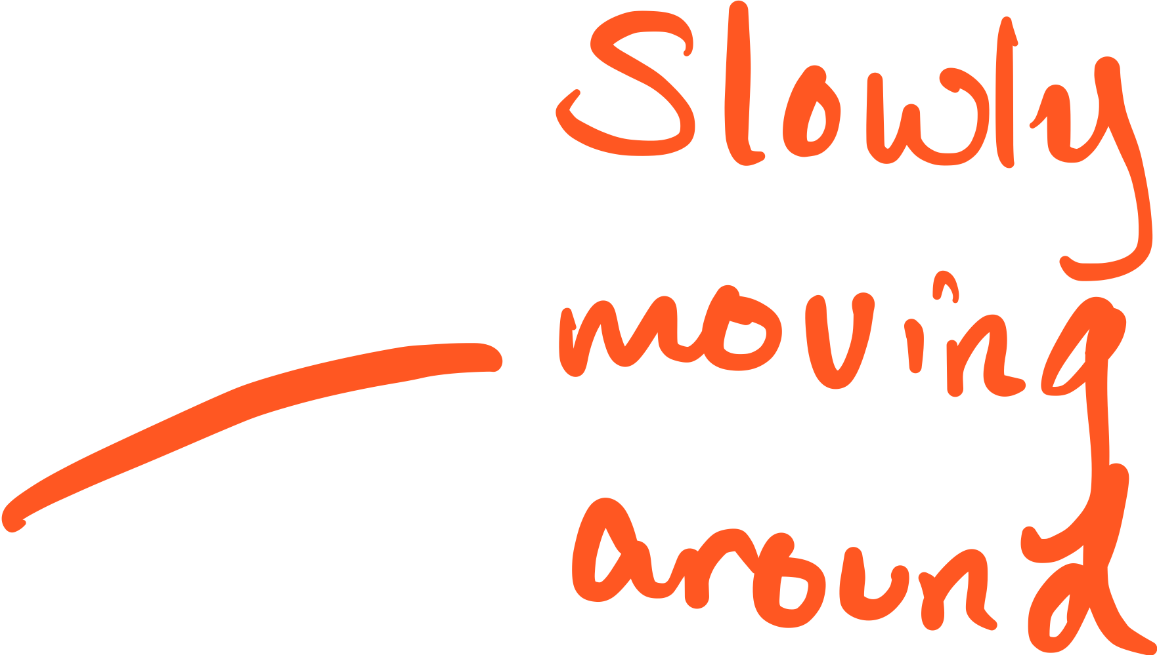
Major Design Change 1
Near You
Notes:
Changes:
Removed names to prevent clutter.
Added percentage and stroke around bubbles.
Added movement indicator around bubbles.

Slide 10
Before
After
Feedback: Users liked the different bubble sizes but was unsure if it meant distance or compatibility.
Change 1: We added match percentage and proportional stroke around bubbles.
Users will know that bubble sizes are proportional to their match score instead of their distance by seeing bigger bubbles with larger scores.
Change 2: Bubbles will bob around slowly instead of staying fixed.
To further dissociate bubbles with distance (prevent the idea that the screen is a map), the bobbing will indicate that bubble positions are random, not fixed in place by distance as a map would be.
Notes:
Changes:
Removed names to prevent clutter.
Added percentage and stroke around bubbles.
Added movement indicator around bubbles.

Slide 11
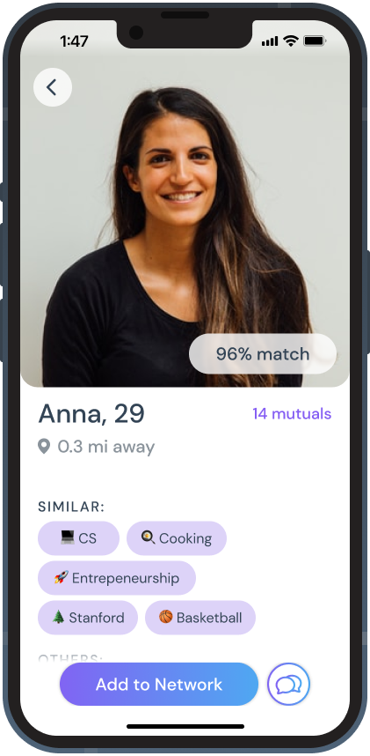
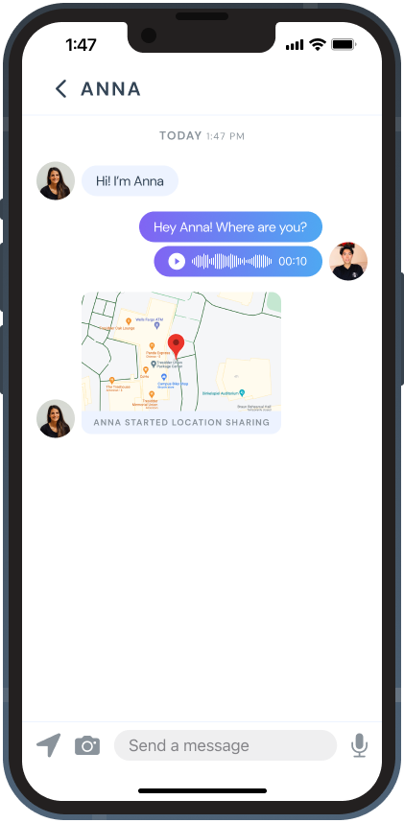
Task #1
Befriend someone near you (Anna) with similar interests.
Click on a bubble to see someone’s profile.
Select Add to Network to finish task (sends request). End of task.
Click Message icon to send a message to Anna (optional).

Slide 12
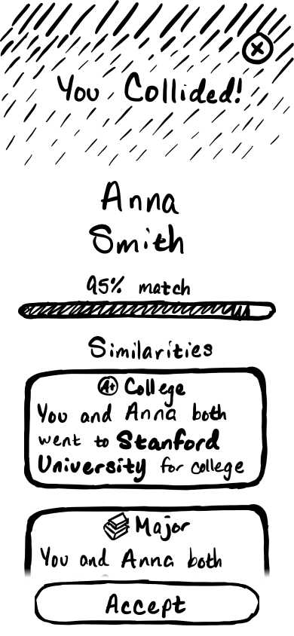
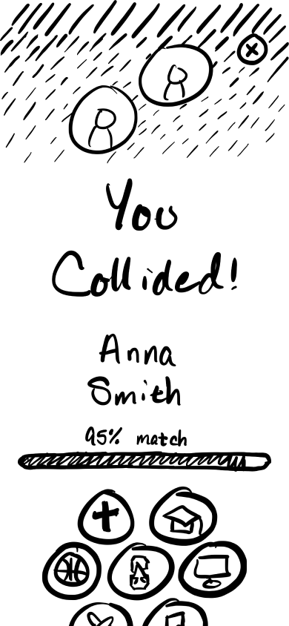
Major Design Change 2
Collision
Notes:
Changes:
Removed names to prevent clutter.
Added percentage and stroke around bubbles.
Added movement indicator around bubbles.

Slide 13
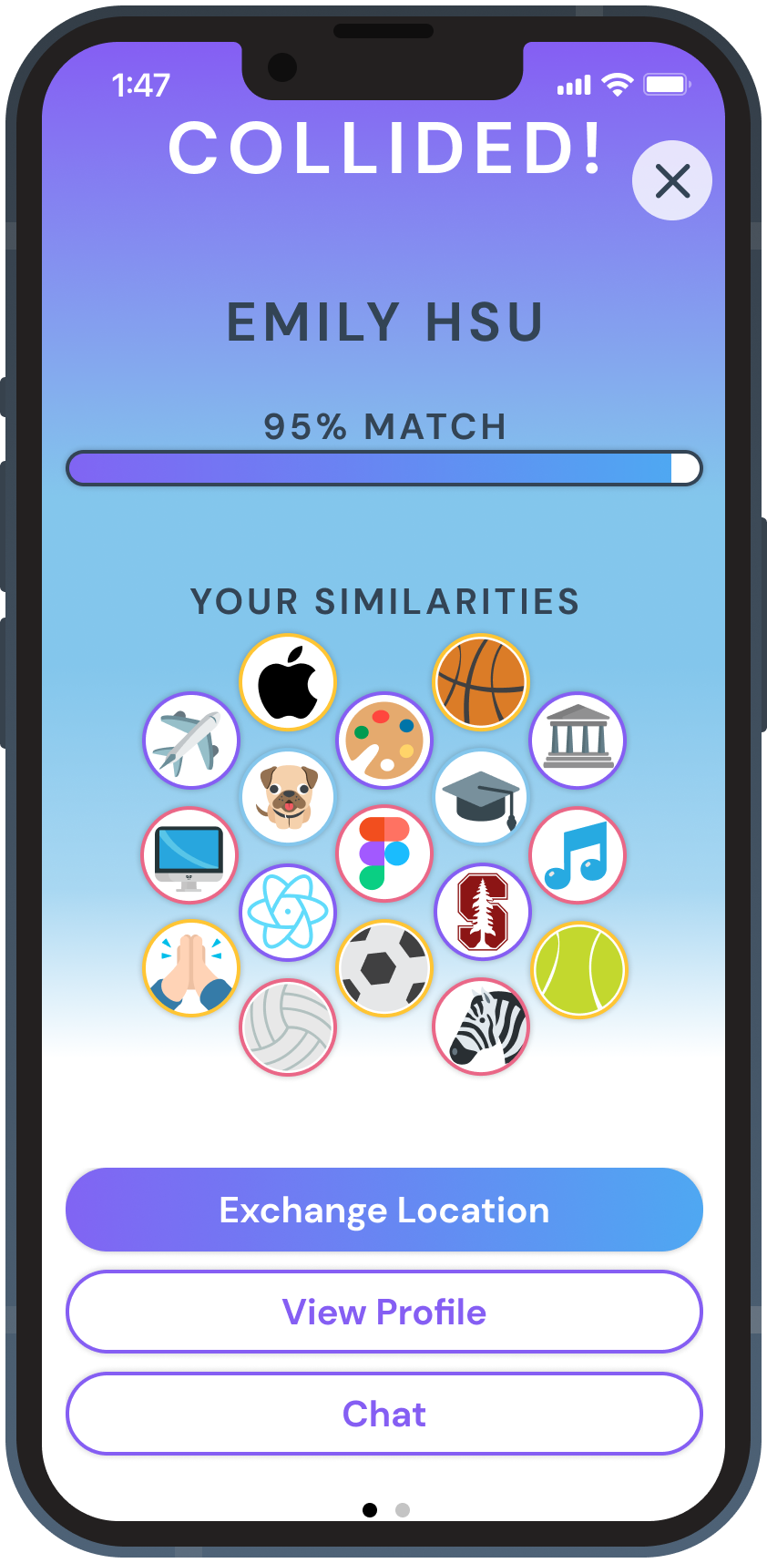
Before
After
Feedback: Users said they would not look down at phone while talking.
Change 1: We replaced the similarities list with icons diagram.
While users are walking or talking to the other person, they are unlikely to look down at their phones for a prolonged time, so we want them to get a general gist with a glance.
Feedback: Users were unsure what “accepting” a collision entailed.
Change 2: We replaced “Accept with 3 buttons stating explicit actions.
This eliminates users’ confusion and concerns on privacy, and creates more options for them to evaluate and interact with the match before having personal interaction.
Scrolled down
Notes:
Changes:
Removed names to prevent clutter.
Added percentage and stroke around bubbles.
Added movement indicator around bubbles.

Slide 14
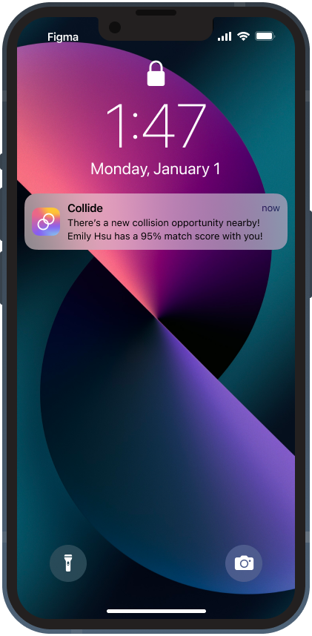
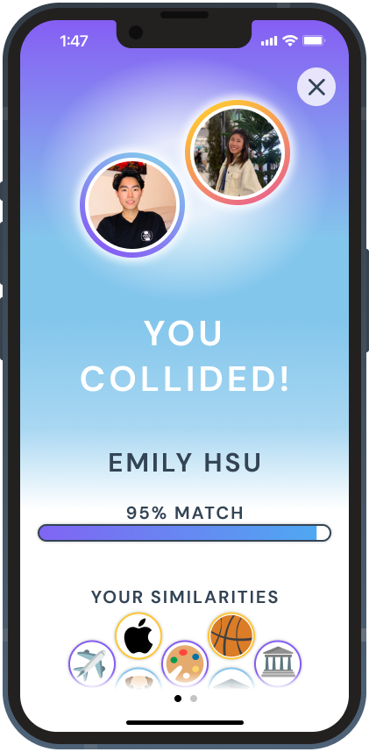
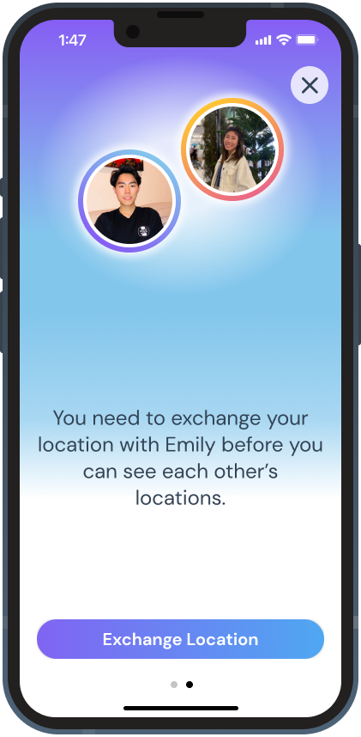
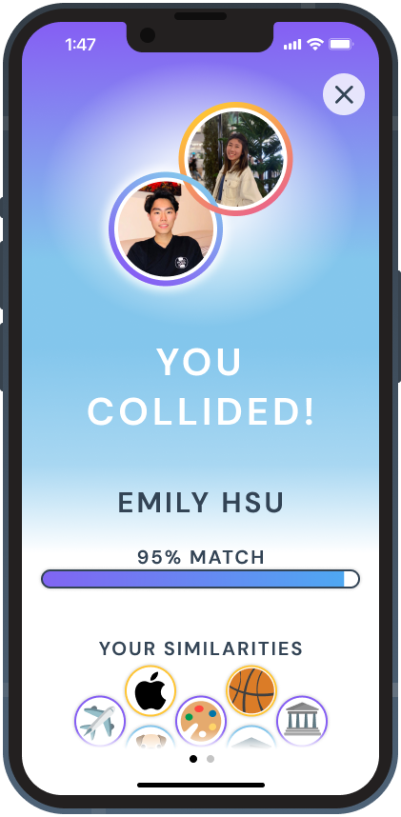
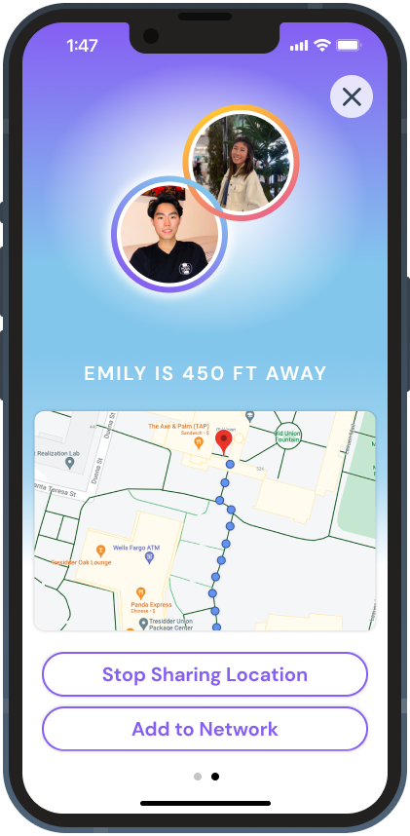
Task #2
Start a conversation with someone (Emily) in person.
Swipe between screens
Swipe between screens
Received notification. Click to open app.
View similarities. Choose to view profile or share location.
Choose to exchange location.
Ability to see similarities while location sharing.
Locate person with map. Choose to add to Network. End of task.

Slide 15
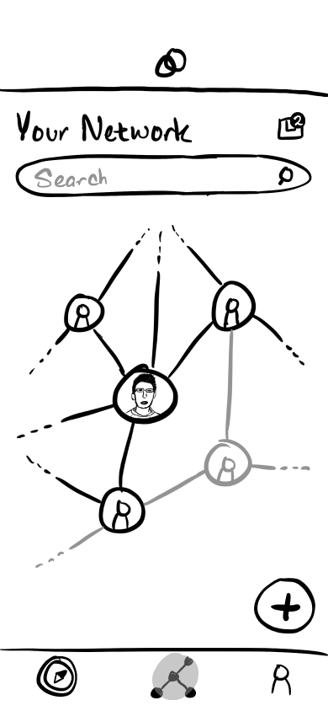
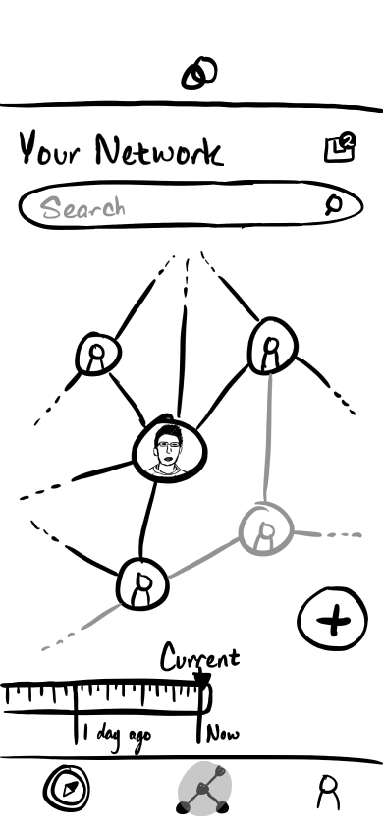
Major Design Change 3
Network
Notes:
Changes:
Removed names to prevent clutter.
Added percentage and stroke around bubbles.
Added movement indicator around bubbles.

Slide 16
Before
After
Feedback: Users try to click on picture of self when adding a friend.
Change 1: We indicate yourself with a different color.
The purple differentiates the user from the rest of the people and makes the center of the network clear.
Feedback: Users really enjoyed the network concept
Change 2: Make interface more interactive (zoom, scroll, etc) and added a timeline filter.
This makes the tree building process more fun and makes filtering out earlier connections easier
Notes:
Changes:
Removed names to prevent clutter.
Added percentage and stroke around bubbles.
Added movement indicator around bubbles.

Slide 17
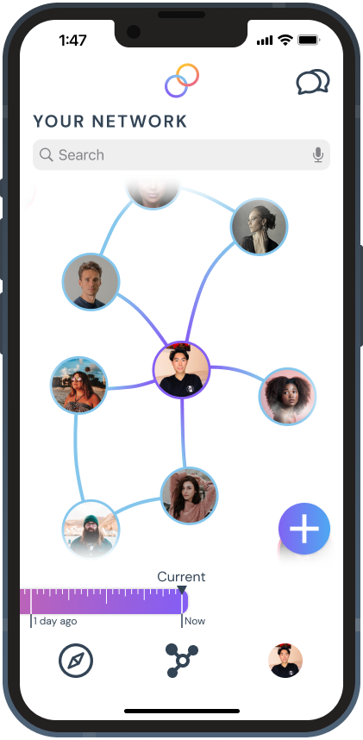
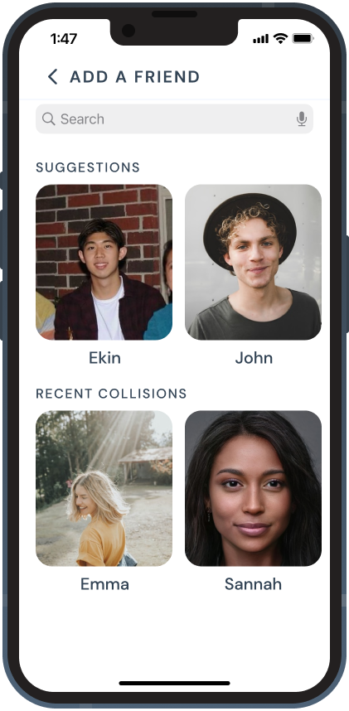
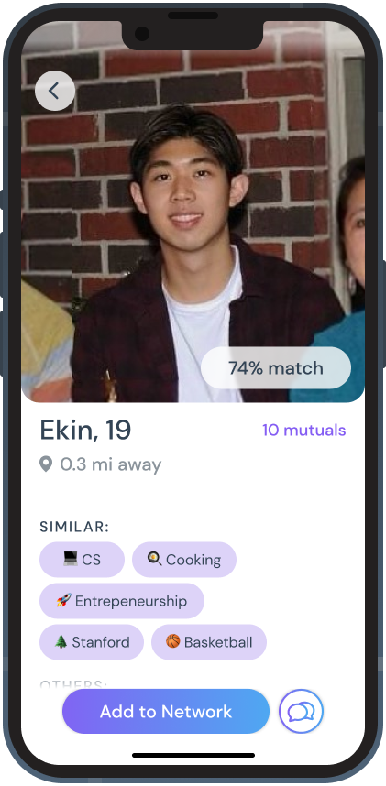
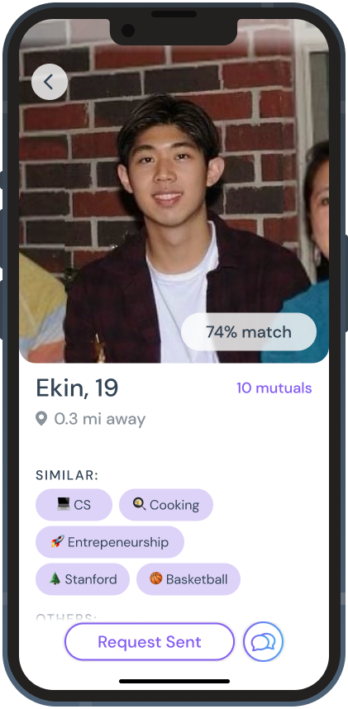
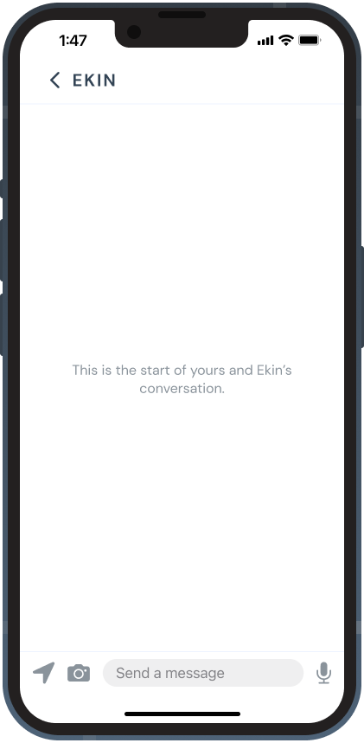
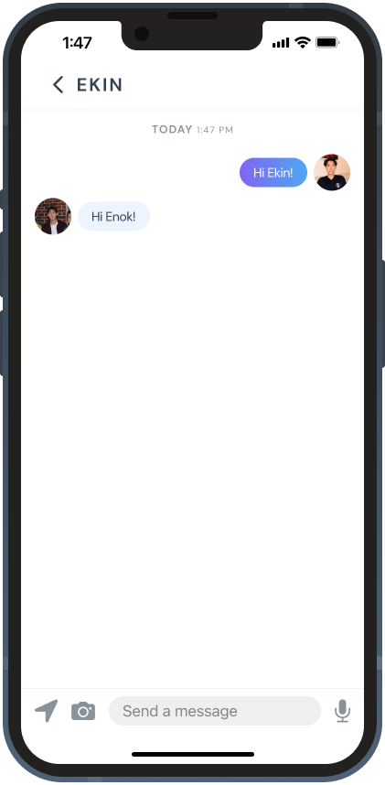
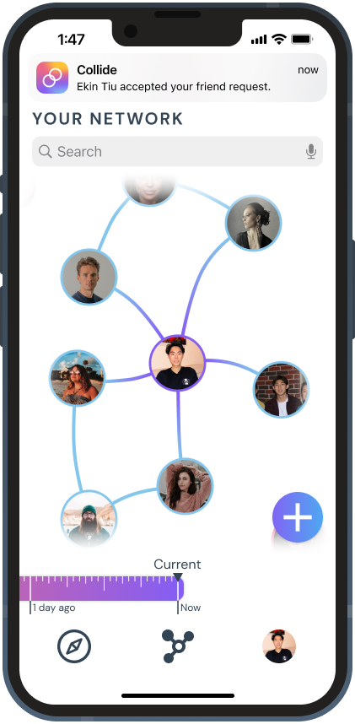
Task #2
Add a past friend (Ekin) to your existing network
Click “+” button to add friend
Click Ekin from suggestions.
Request to add Ekin to network.
Use message icon to send message.
Send message by clicking text field.
Go back to main network page.
Ekin accepts request. End of task.

Slide 18
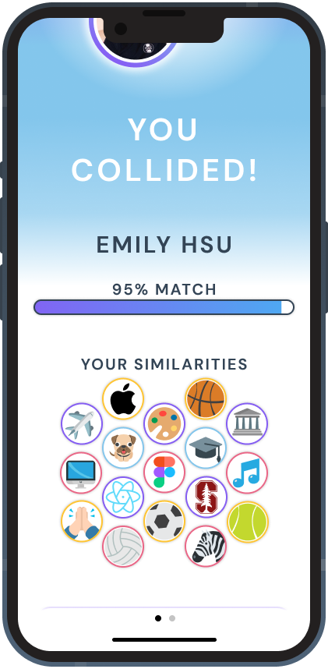
Prototype

Slide 19
Design / Prototyping Tools
We used Figma to create the med-fi prototype, since it allows users to both:
explore our graphical user interface,
and navigate through our intended task flows.
What was easy:
Learning curve not steep, very accessible
Experimenting and collaborating on UX design
What was hard:
Making animations – frame by frame
Setting up swiping between pages

Slide 20
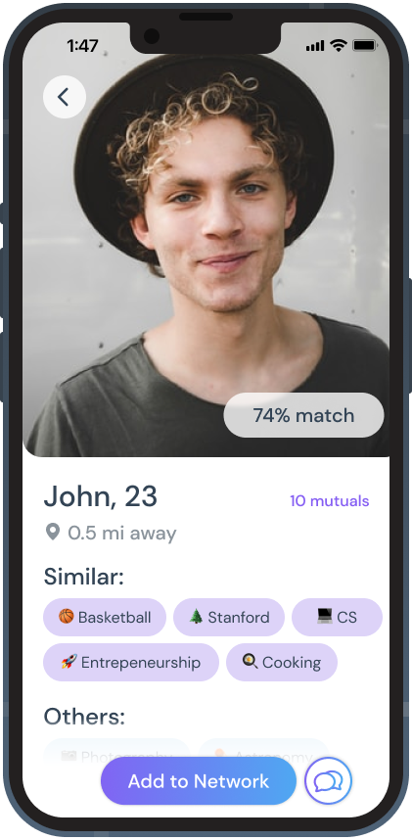
Limitations / Tradeoffs
Users can’t add their own interests to the prototype
Not necessary since prototype cannot match users anyways
All other profiles and locations (map) are hard coded
Hard (almost impossible) to obtain this information through Figma
Not required to test user experience with task flows
Sample profile with fake interests

Slide 21
Limitations / Tradeoffs cont.
User can’t interact with his/her own profile screen
Not included since this is not related to any of our three primary tasks
CON: Many buttons in our task flows could navigate to profile screen, but we are forced to restrict navigation since the screen is not yet developed
Can only add certain people to their network (not all profile buttons are clickable)
Would be time-consuming to create med-fi screens for each fake profile
One fake profile is enough to see how users engage with another person’s profile
CON: Users forced / restricted to a subset of possible task flows

Slide 22
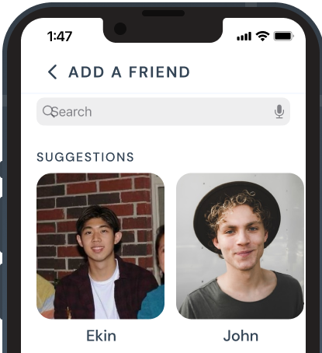
Wizard of Oz Techniques
Matching Algorithm
Suggestions to Add to Network
A suggestions algorithm would be impractical without having existing users, so we make fake suggestions for past friends to add on the platform.
No matching algorithms, so we act as the matching algorithm by hard coding fake match scores.

Slide 23
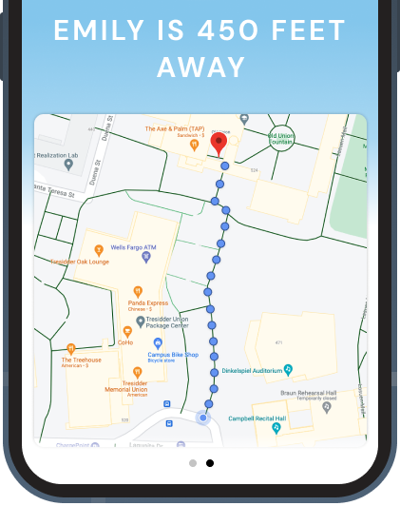
Hard-Coded Features
Map to Find Match
Network
Profile Information
We use a screenshot from Google Maps, and do not use any real location information.
All connections to other users on the platform at each time stamp are manually created.
WHY Hard Coded?
No users on the platform,
No way to extract this information (profiles and location)
not necessary to test user experience and task flows.
All profiles, shared interests, and match scores are hard-coded elements in all screens.

Slide 24
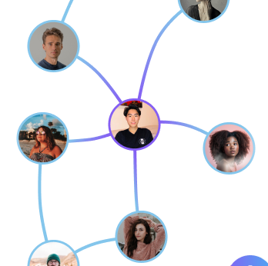
Summary of Improvements
Added match percentages to people’s bubbles on potential matches Home Screen
Replaced “Similarities” list with bubbles showing similarities with icons
Indicated self with a different color to help users distinguish between bubbles, and made network interactive (e.g. scroll, zoom, etc)

